Slide 1

CMR COLLEGE OF ENGINEERING & TECHNOLOGY
Kandlakoya, Medchal, Hyderabad - 501401
Department of Computer Science and Engineering
Diabetes Disease Prediction Using Machine
Learning Algorithms
G.Harshitha - 19H51A0509
G.Vinay - 19H51A05D4
J.Vishnukanth - 20H55A0511
Under esteemed guidance of
Mr.B.Sivaiah( Associate Professor )

Slide 2


CONTENTS:
Abstract
Literature Survey
Existing Works
Results of Existing System
Proposed Solution
Implementation
Plan of Execution
Conclusion
References

Slide 3
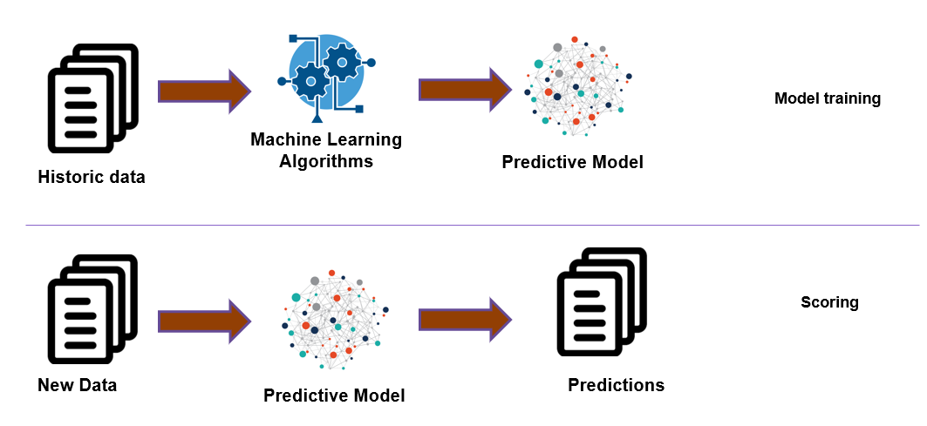

ABSTRACT
Aim:To develop a machine learning model that can predict diabetes disease.
Machine Learning is a technology that helps computer to learn and act accordingly.
It helps the computer to learn the complex model and predict the data.
The value of machine learning is recognized well in health care industry which has large pool of data.
The proposed project is based on a typical machine learning algorithm.

Slide 4

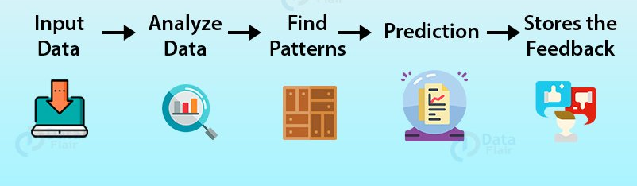
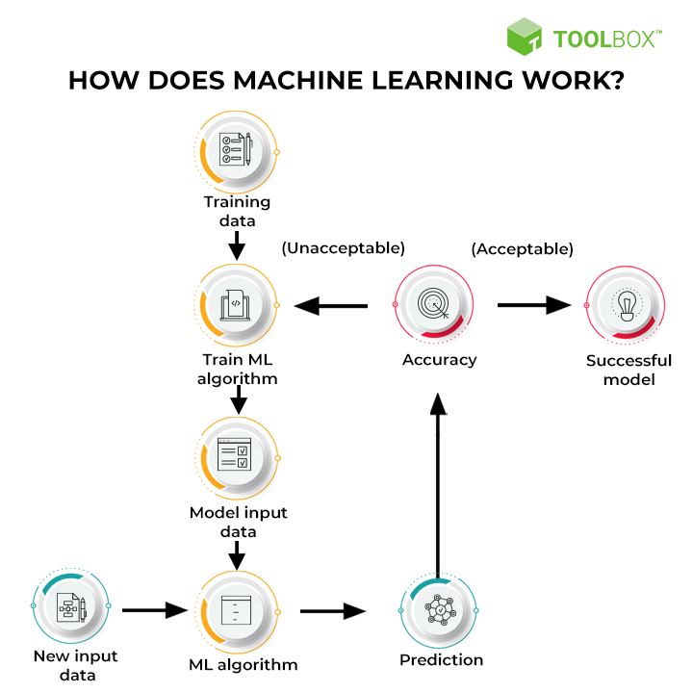
Literature review
The analysis of related work gives results on various healthcare datasets, where analysis and predictions were
carried out using various methods and techniques.
Various prediction models have been developed and implemented by various researchers using variants machine learning algorithms or also combination of these techniques.
Diabetes disease prediction using machine learning on Big Data of healthcare.
The A. Mir and S. N. Dhage have used the WEKA tool for data analytics for diabetes disease prediction on Big Data of healthcare.
They used the publicly available dataset from UCI and applied different machine learning classifiers on it.
The classifiers which they incorporated are Naive Bayes, Support Vector Machine, Random Forest and Simple CART.
Their approach starts with accessing the dataset, pre-process it in Weka tool and then did the 70:30 train and test split for applying different machine algorithms.
They did not go with the cross-validation step as it is imperative to get the optimal and accurate results as well.

Slide 5
Literature review
An Intelligent System for Diabetes Prediction
Dataset was collected from three different locations, and the proposed model was validated on this dataset.
Eight attributes were present inside the dataset, and it consisted of 402 patients, amongst which 80 patients were type 2 diabetic.
The divided the dataset into 50% training set and 50% testing set.
The model was proposed using a combination of naïve Bayes and support vector machine algorithms for diabetes prediction.
Ensemble of naïve Bayes and support vector machine has achieved the accuracy of 97.6%, which is far better than the algorithms when run alone on the dataset, that is, Naïve Bayes achieving an accuracy of 94.52 and support vector machine achieving 95.52%.
The authors have not mentioned any pre-processing technique to filter out any unwanted values from the dataset.
Analysis and prediction of diabetes using machine learning
S. Saru and S. Subashree used WEKA software was employed as a mining tool for diagnosing diabetes.
The Pima Indian diabetes database was acquired from UCI repository used for analysis.
The dataset was studied and analysed to build an effective model that predicts and diagnoses diabetes disease.
In this study, we aim to apply the bootstrapping resampling technique to enhance the accuracy and then applying Naïve Bayes, Decision Trees and (KNN) and compare their performance.

Slide 6
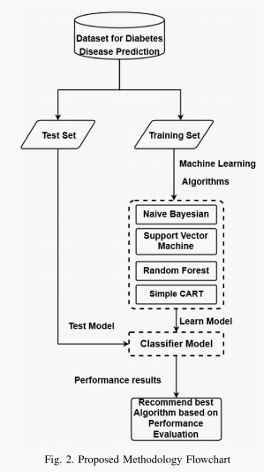
Existing Models Working
Diabetes disease prediction using machine learning on big data
of healthcare:
Step 1: Pre-process the input dataset(Pima Indian diabetes database was acquired from UCI repository) for diabetes disease in WEKA tool.
Step 2: Perform percentage split of 70% and 30% to divide dataset as Training set and Test set.
Step 3: Select the machine learning algorithm i.e. Naive Bayes, Support Vector Machine, Random Forest and Simple CART algorithm.
Step 4: Build the classifier model for the mentioned machine learning algorithm based on training set.
Step 5: Test the Classifier model for the mentioned machine learning algorithm based on test set.
Step 6: Perform Comparison Evaluation of the experimental performance results obtained for each classifier.
Step 7: After analyzing based on various measure conclude the best performing algorithm.
The proposed classifier model has been built using WEKA tool and based on successful execution of each step we can evaluate the experimental results.

Slide 7
An Intelligent System for Diabetes Prediction
Step 1: Dataset was collected from three different locations, and the proposed model was validated on this dataset. Eight attributes were present inside the dataset, and it consisted of 402 patients, amongst which 80 patients were type 2 diabetic
Step 2: Perform percentage split of 50% and 50% to divide dataset as Training set and Test set.
Step 3: Select the machine learning algorithm i.e. naïve Bayes and support vector machine algorithms for diabetes prediction.
Step 4: Build the classifier model for the mentioned machine learning algorithm based on training set.
Step 5: Test the Classifier model for the mentioned machine learning algorithm based on test set.
Step 6: Perform Comparison Evaluation of the experimental performance results obtained for each classifier.
Step 7: After analyzing based on various measure conclude the best performing algorithm.

Slide 8
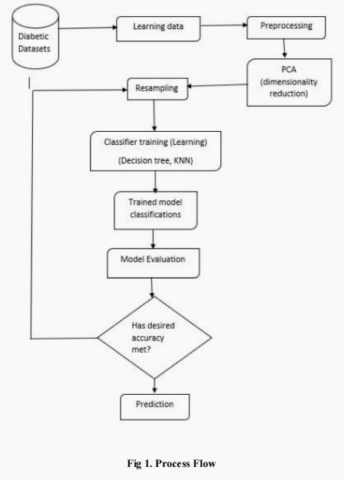
Analysis and prediction of diabetes using machine learning
Step 1: Preprocess the input dataset(Pima Indian diabetes database was acquired from UCI repository) for diabetes disease in WEKA tool.
Step 2: Feature extraction through principal component analysis(PCA). They applied the bootstrapping resampling technique to enhance the accuracy.
Step 3: Select the machine learning algorithm i.e. Logistic regression with SVM, Decision Trees and (KNN)
Step 4: Build the classifier model for the mentioned machine learning algorithm based on training set.
Step 5: Test the Classifier model for the mentioned machine learning algorithm based on test set.
Step 6: Perform Comparison Evaluation of the experimental performance results obtained for each classifier.
Step 7: After analyzing based on various measure conclude the best performing algorithm.
The proposed classifier model has been built using WEKA tool and based on successful execution of each step we can evaluate the experimental results.

Slide 9
Existing Models results
Diabetes disease prediction using machine learning on big data
of healthcare:
RESULT:
Algorithm | Accuracy value | Precision | Recall | F-Measure
Naïve Bayes | 0.770 | 0.767 | 0.770 | 0.768
Support Vector Machine | 0.791 | 0.784 | 0.791 | 0.782
Random Forest | 0.765 | 0.756 | 0.765 | 0.758
Simple Cart | 0.765 | 0.762 | 0.763 | 0.446

Slide 10
An Intelligent System for Diabetes Prediction
RESULT:
Algorithm | No.of records | Train set /Test set | No. of correctly classified | No. of Incorrectly Classified records | Classifier performance
SVM | 402 | 201/201 | 192 | 9 | 95.52%
Naïve Bayes | 402 | 201/201 | 190 | 11 | 94.53%

Slide 11
Analysis and prediction of diabetes using machine learning
RESULT:
Classifiers | Without Bootstrapping (Accuracy Rate%) | After Bootstrapping (Accuracy Rate%)
Logistic Regression with SVM | 71.45% | 74.89%
Decision Tree | 78.43% | 94.4%
K-NN(k=1) | 69.93% | 93.79%
K-NN(k=3) | 72.2% | 76.69%

Slide 12
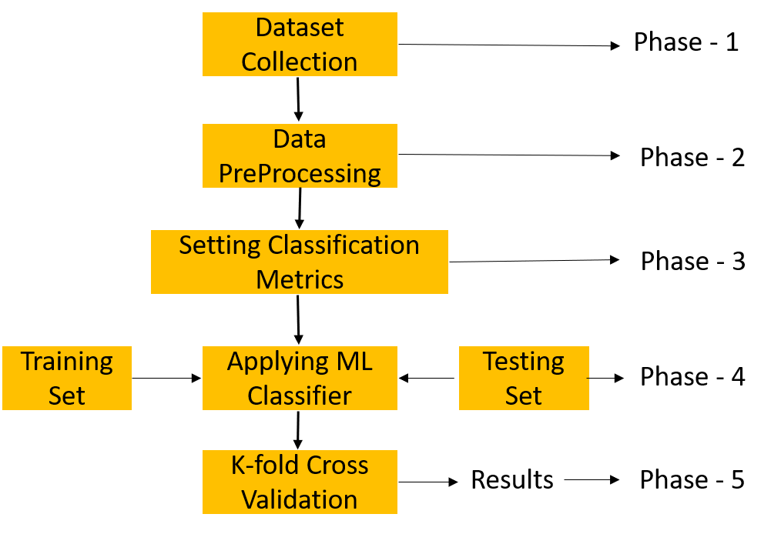
PROposed solution
The proposed solution is we are implementing an application where it will be helpful to predict diabetes disease in early stage.
To find the most optimal results in terms of accuracy and computational time for Diabetes disease prediction using machine learning.
It focus on prediction of diabetes using health records of the diabetic patients.
By using machine learning techniques, knowledge is acquired through these records, containing numerical values, to predict whether the patient is having diabetes or not.

Slide 13
Data collection
Features | Description
Pregnancies | Number of Pregnancies patients had earlier.
Glucose | Glucose level present in the patient.
Blood Pressure | Recorded blood pressure level at that particular time.
Skin Thickness | Skin thickness level of the patient.
Insulin | Amount of Insulin present in the body.
BMI | Body Mass Index of the individual.
Diabetes Pedigree Function | Family history of Diabetes disease.
Age | Age of an individual.

Slide 14
Architecture/Block diagram
Service provider
Login,
Train and Test Data Sets,
View Trained and Tested Accuracy in Bar Chart,
View Trained and Tested Accuracy Results,
Find Diabetic Status From Data Set Details,
Find diabetic Ratio on Data Sets,
View All Emergency For Diabetic Treatment,
Download Trained Data Sets,
View Diabetic Ratio Results,
View All Remote Users.
Accepting all user information
Admin
View user data details
Authorize
The admin
Registering the user
Stored and retrievals
WEB
Database
Remote user
REGISTER AND LOGIN,
POST DIABETIC DATA SETS,
SEARCH AND PREDICT DIABETIC STATUS,
VIEW YOUR PROFILE

Slide 15
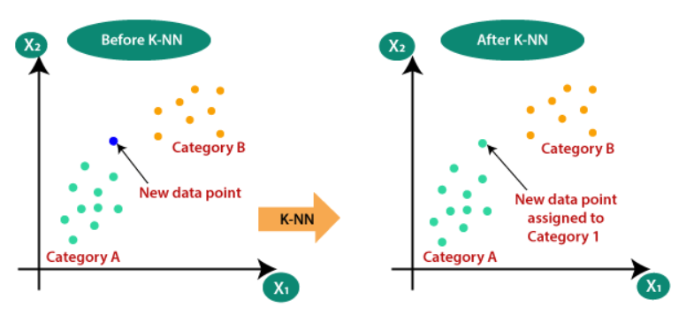
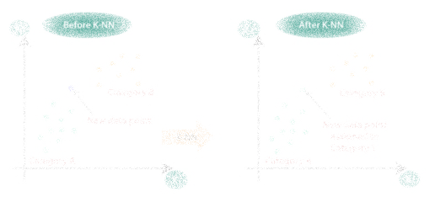
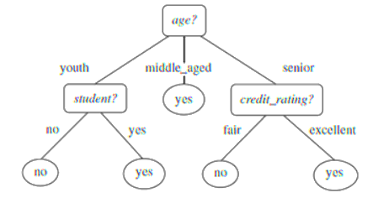
Algorithms used
K-Nearest Neighbours:
The k-nearest neighbors algorithm, is a non-parametric, supervised learning classifier, which uses proximity to make classifications or predictions about the grouping of an individual data point.
K-NN algorithm stores all the available data and classifies a new data point based on the similarity.
Naive Bayes:
Naïve Bayes algorithm is a supervised learning algorithm, which is based on Bayes theorem and used for solving classification problems.
It is a probabilistic classifier, which means it predicts on the basis of the probability of an object.
P(A|B)=
P(B|A)P(A)
P(B)
Decision Tree Classifier:
Decision Trees (DTs) are a non-parametric supervised learning method used for classification and regression.
The goal is to create a model that predicts the value of a target variable by learning simple decision rules inferred from the data features. It has the ability to use different feature subsets and decision rules at different stages of classification.

Slide 16
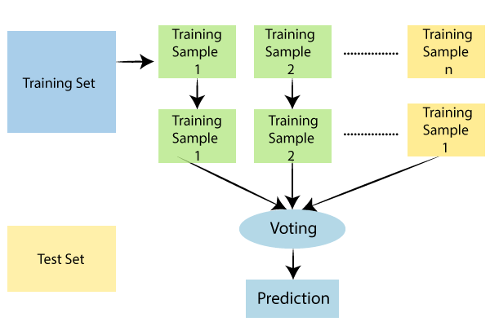
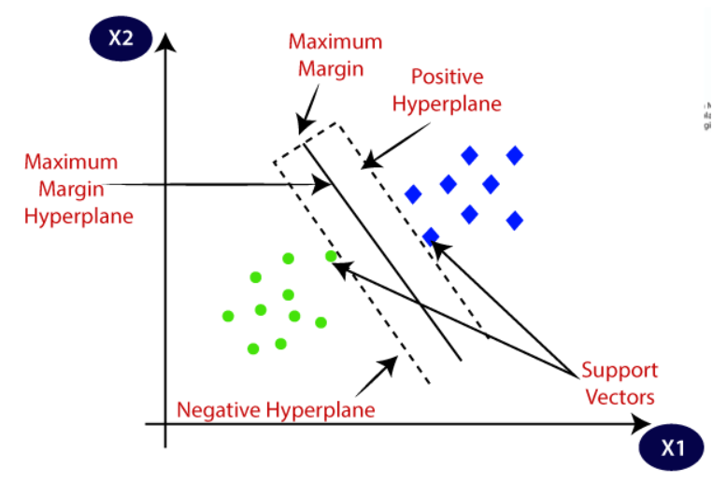
Random Forest:
The random forest algorithm is made up of a collection of decision trees, and each tree in the ensemble is comprised of a data sample drawn from a training set with replacement, called the bootstrap sample.
Support Vector Machine:
The goal of the SVM algorithm is to create the best line or decision boundary that can segregate n-dimensional space into classes so that we can easily put the new data point in the correct category in the future. This best decision boundary is called a hyperplane.
SVM chooses the extreme points/vectors that help in creating the hyperplane. These extreme cases are called as support vectors, and hence algorithm is termed as Support Vector Machine.

Slide 17
implementaion
Flow Chart: Remote User
Start
Login
Yes
Status
No
Register and login
Username & Password
Wrong
Post Diabetic Datasets
Search and predict diabetic status view your profile
Logout

Slide 18
Flow Chart: Service Provider
Start
Login
Yes
Status
No
Browse data sets and train & test with classifiers
Username & Password
Wrong
View trained and tested accuracy in bar chart
View trained and tested accuracy results
Find diabetic status from data set details
Find diabetic ratio on data sets
View all emergency for diabetic treatment
Download trained data sets
View diabetic ratio results, view all remote users
Logout

Slide 19
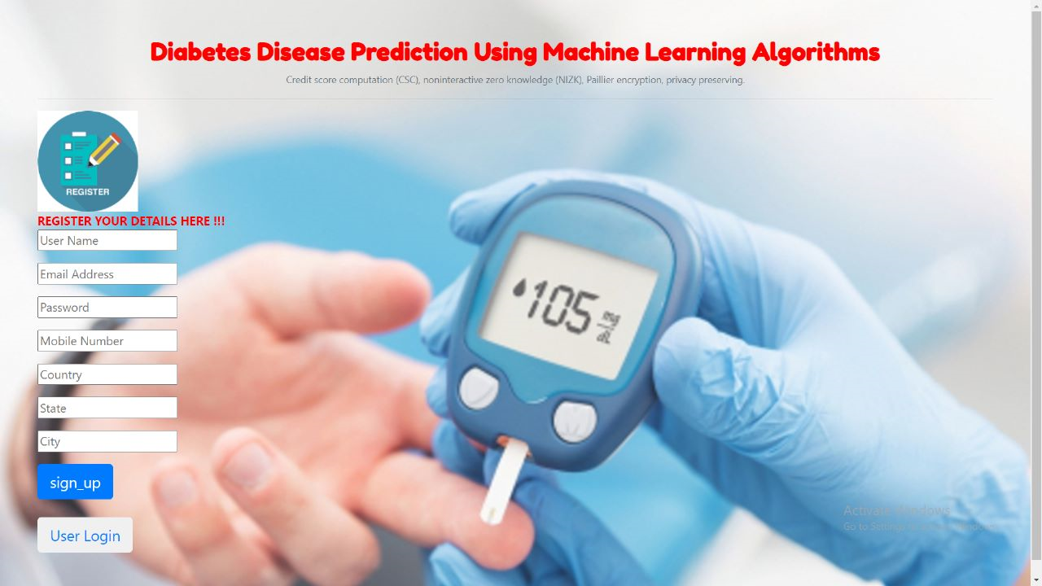
Status of implementaion
Random user registeration page:

Slide 20
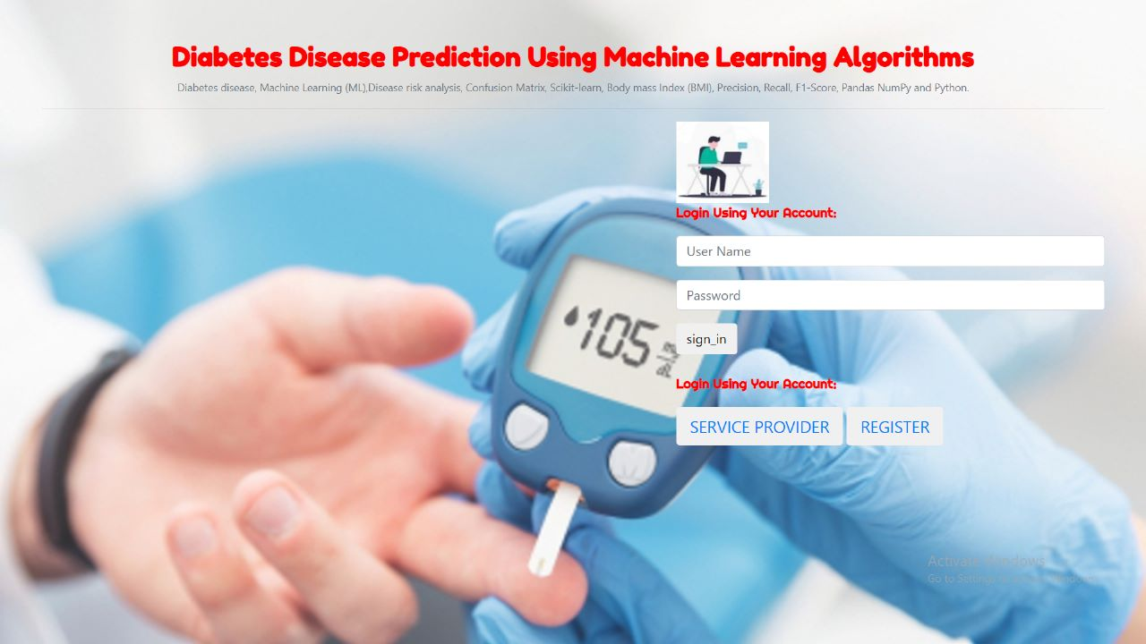
Random User login page:

Slide 21
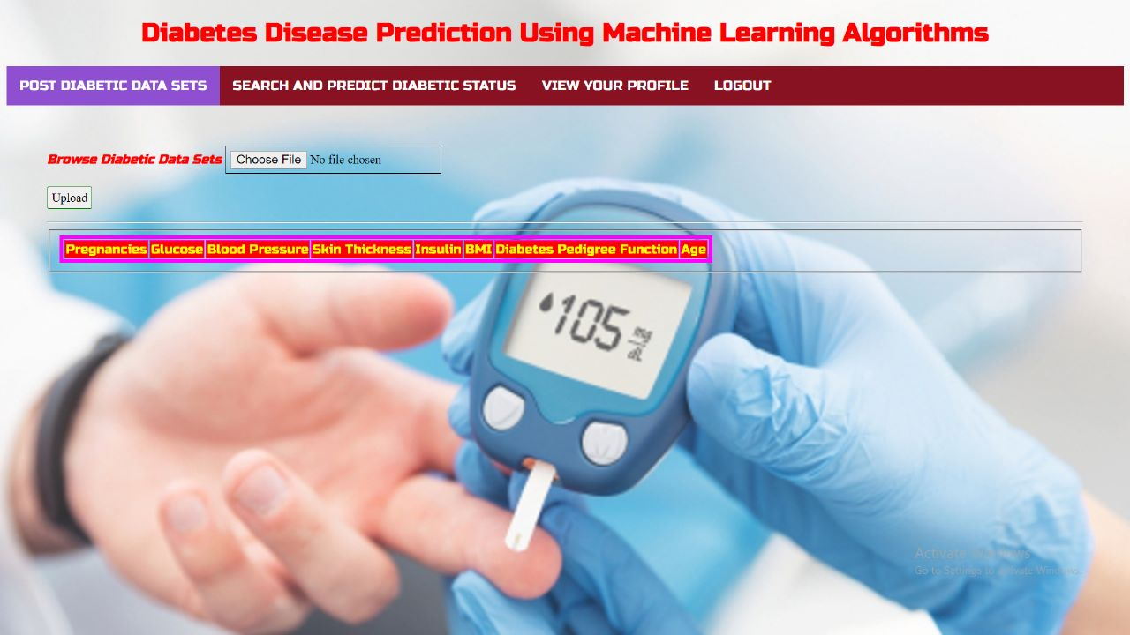
Random user login page:

Slide 22
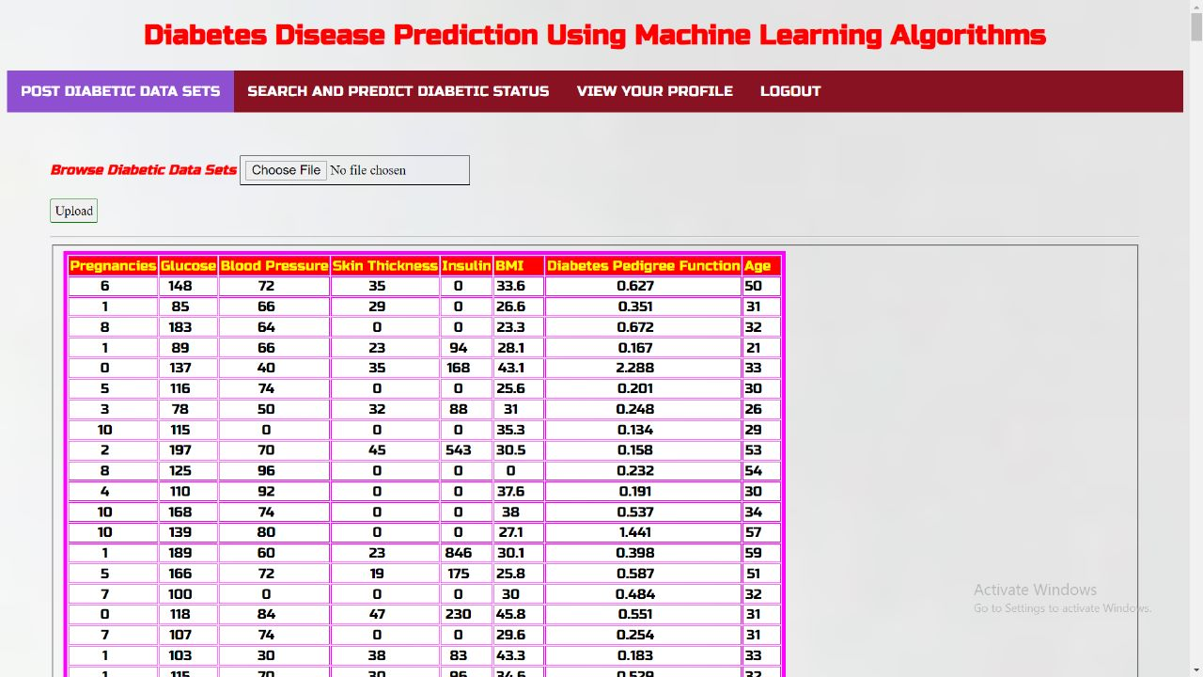
Post diabetes dataset page:

Slide 23
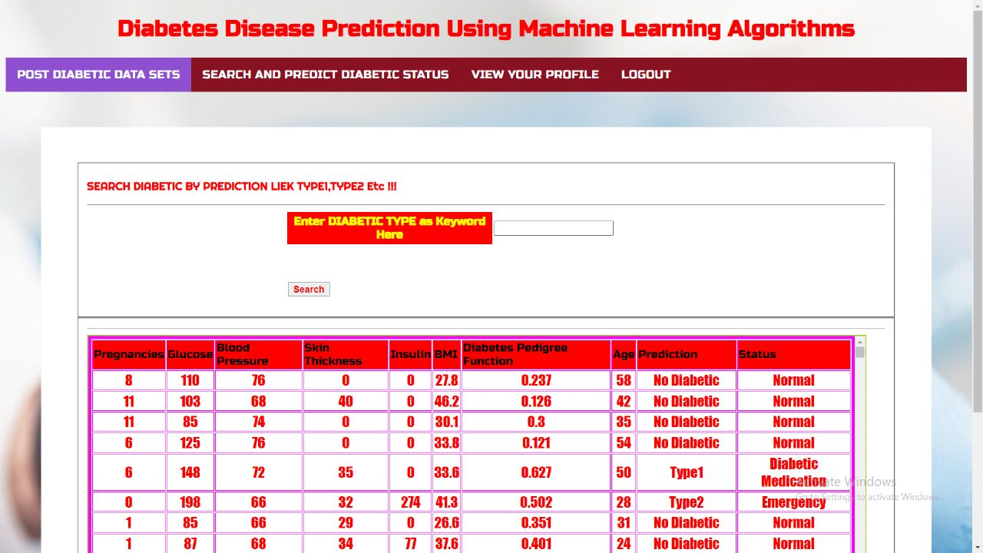
Search and predict diabetes page:

Slide 24
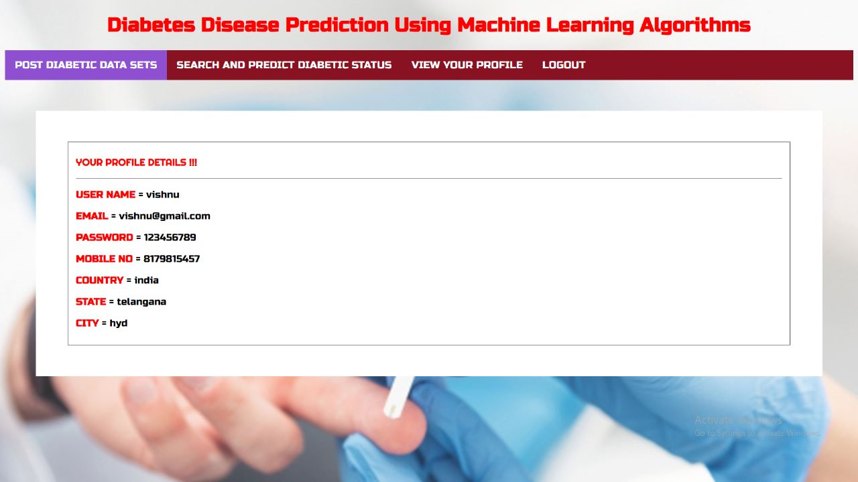
View user profile page:

Slide 25
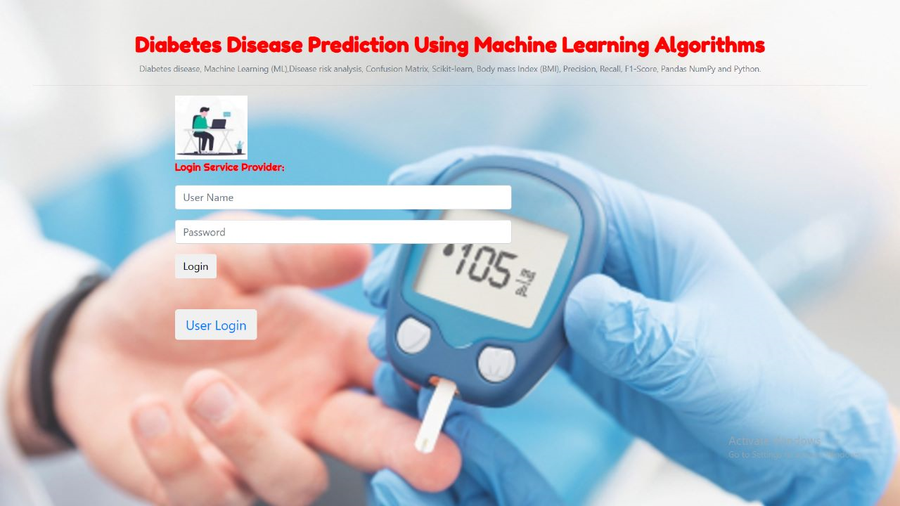
Service provider login page:

Slide 26
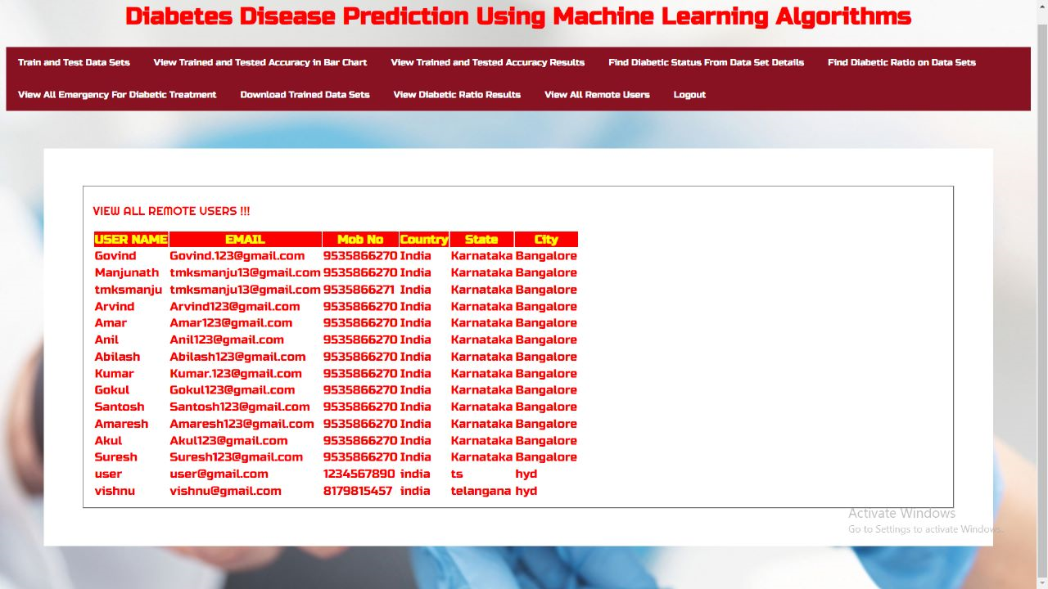
View all remote users page:

Slide 27
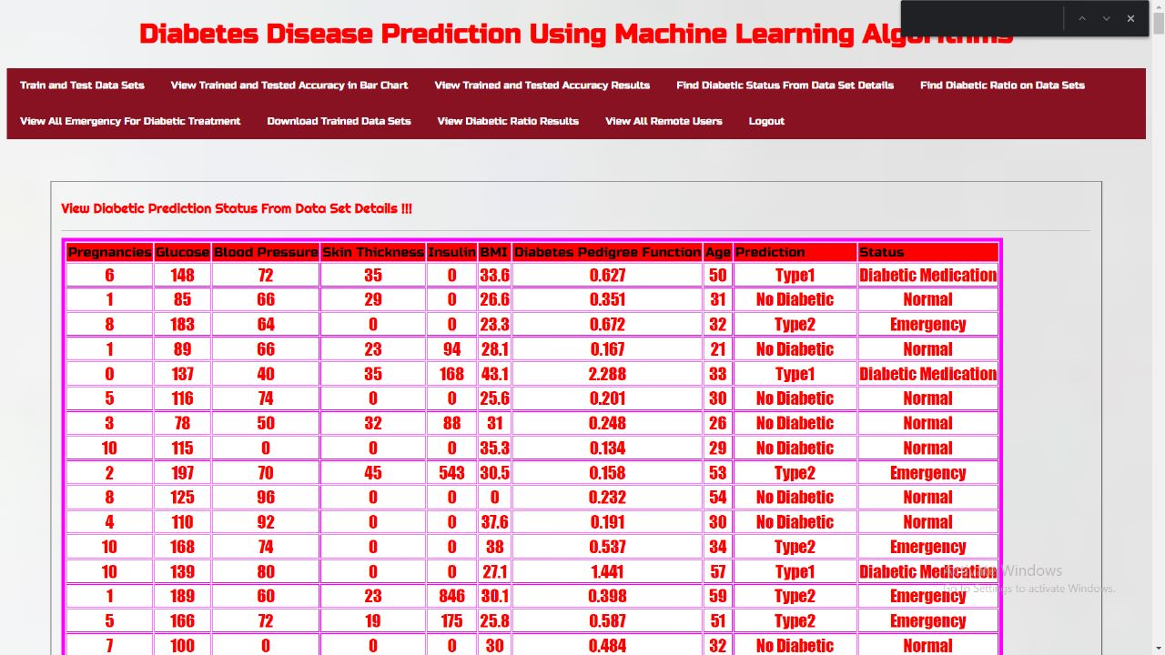
View trained and tested accuracy in bar chart page:

Slide 28
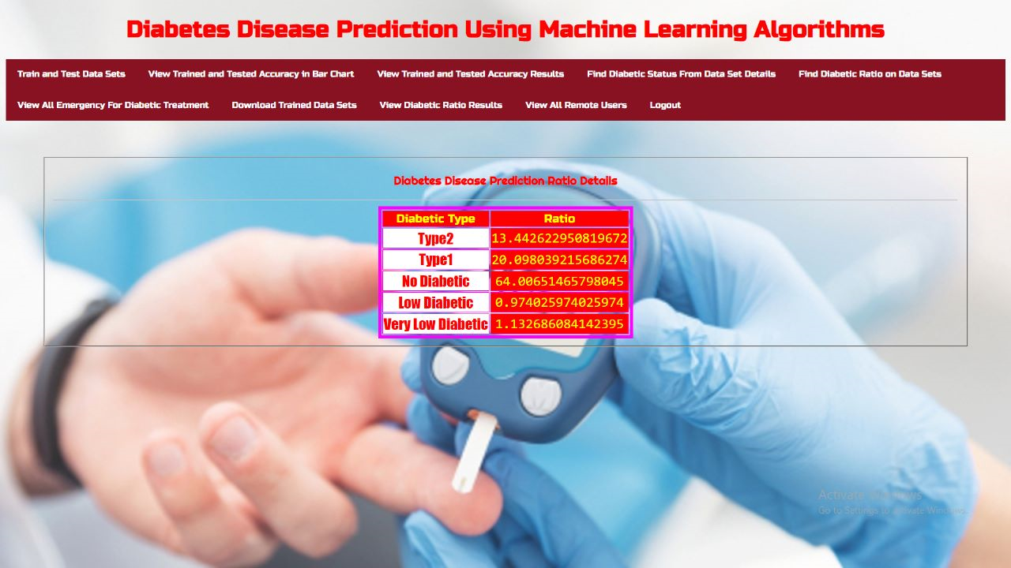
Find diabetic ratio on datasets page:

Slide 29
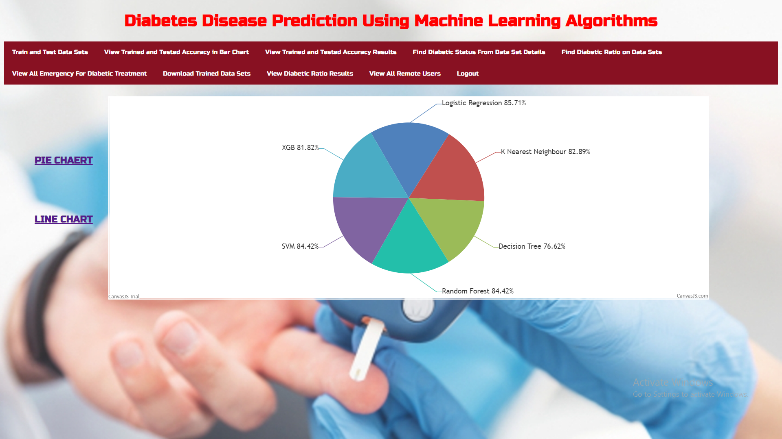
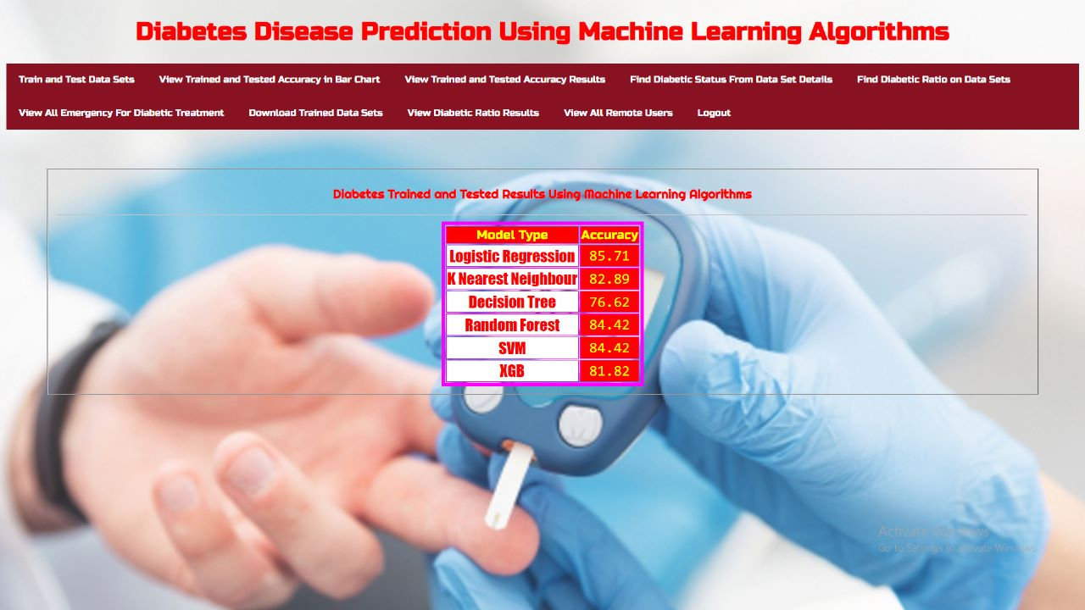
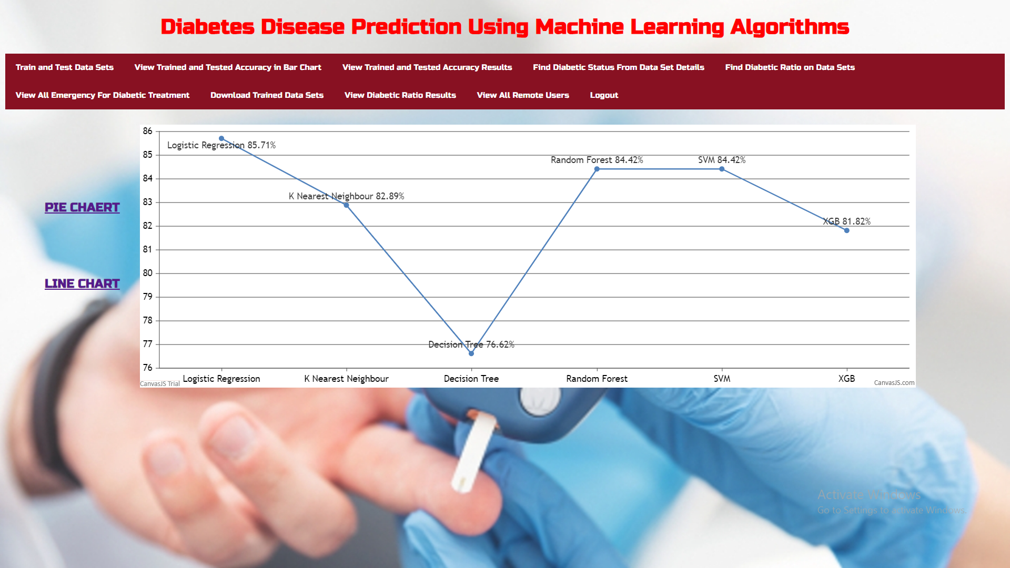
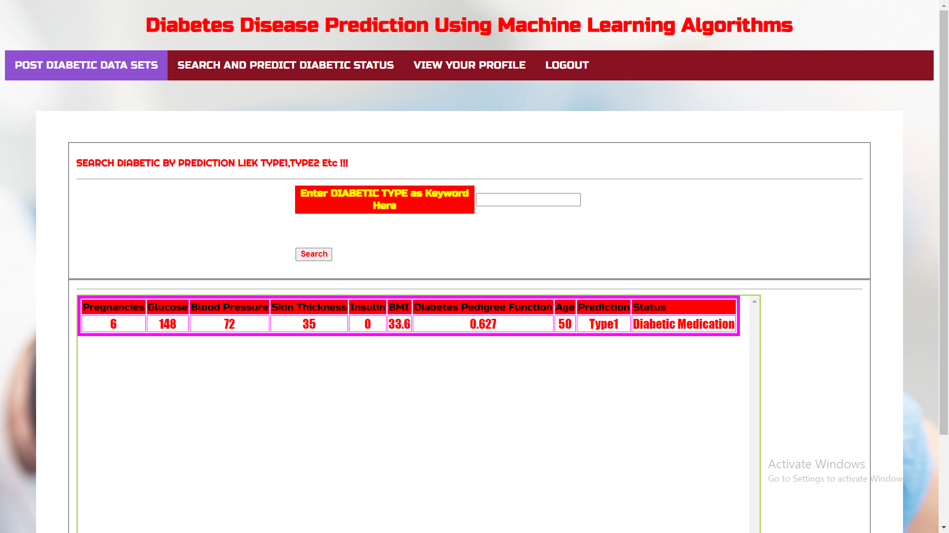
Accuracy of algorithms:

Slide 30
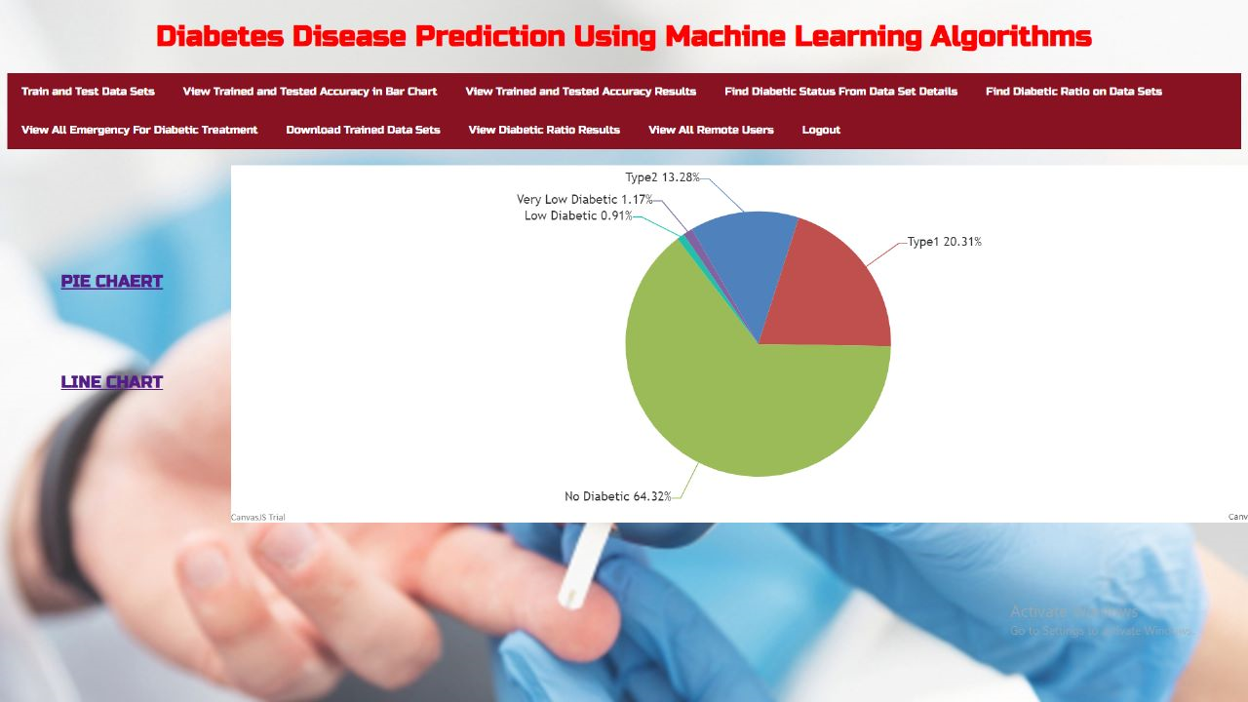
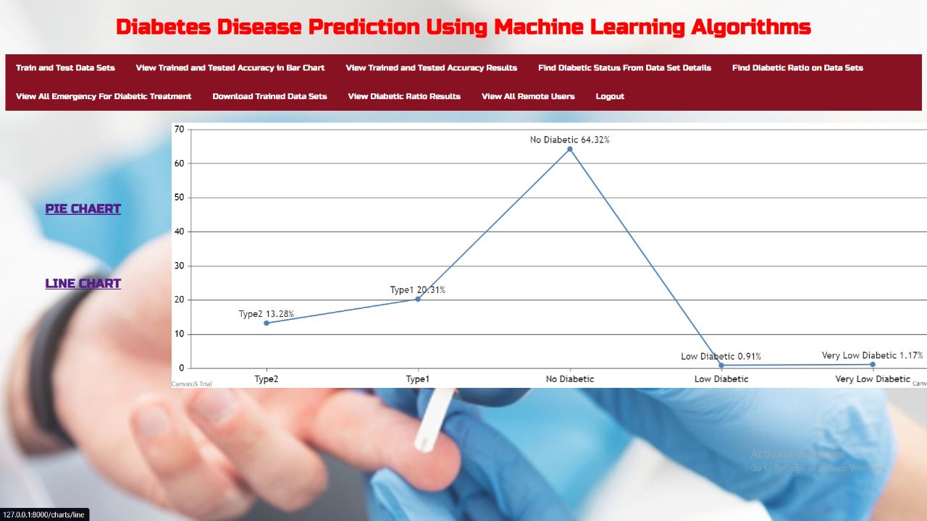
Pie chart and Line chart page:

Slide 31
Plan of execution
Github link of the project repository:
https://github.com/HarshithaGajendrula/Diabetes-Disease-Prediction-Using-Machine-Learning-Algorithms.github.io

Slide 32
CONCLUSION
We have described a machine learning approach to predict diabetes as in early stage diabetes.
Study shows that it's possible for some people to reverse it. Through diet changes and weight loss, you may be able to reach and hold normal blood sugar levels without medication.
Hence it becomes almost mandatory to use machine learning to predict diabetes disease.
Predicted diabetes by using new Machine Learning Algorithms and find out the initial symptoms of diabetes.
The approach is going to compare with different algorithms. The result of our method shows better performance in terms of efficiency and accuracy.

Slide 33
References
[1] P. Saeedi, I. Petersohn, P. Salpea, B. Malanda, S. Karuranga, N. Unwin, S. Colagiuri, L. Guariguata, A. A. Motala, K. Ogurtsova, J. E. Shaw, D. Bright, and R. Williams, “Global and regional diabetes prevalence estimates for 2019 and projections for 2030 and 2045: Results from the international diabetes federation diabetes atlas, 9th edition,” Diabetes Research and Clinical Practice, vol. 157, p.107843, 2019.
[2] A. Mir and S. N. Dhage, “Diabetes disease prediction using machine learning on big data of healthcare,” in 2018 Fourth International Conference on Computing Communication Control and Automation (ICCUBEA), 2018, pp. 1–6.
[3] Z. Tafa, N. Pervetica, and B. Karahoda, “An Intelligent System for Diabetes Prediction,” in Proceedings of the 4th Mediterranean Conference on Embedded Computing (MECO), pp. 378–382, Budva, Montenegro, June 2015.
[4] J. Smith, J. Everhart, W. Dickson, W. Knowler, and R. Johannes, “Using the adap learning algorithm to forcast the onset of diabetes mellitus,” Proceedings - Annual Symposium on Computer Applica_x0002_tions in Medical Care, vol. 10, 11 1988.

Slide 34

THANK YOU

